Slide 1

Using Triton Inference Server

Slide 2
Basic Information
 | DGX
Triton Server Version | 2.6.0 (latest github branch r20.12)
Model Repo | model_repo
HTTP / HTTPS port | 8000
GRPC port | 8001

Slide 3

Basic Usage

Slide 4
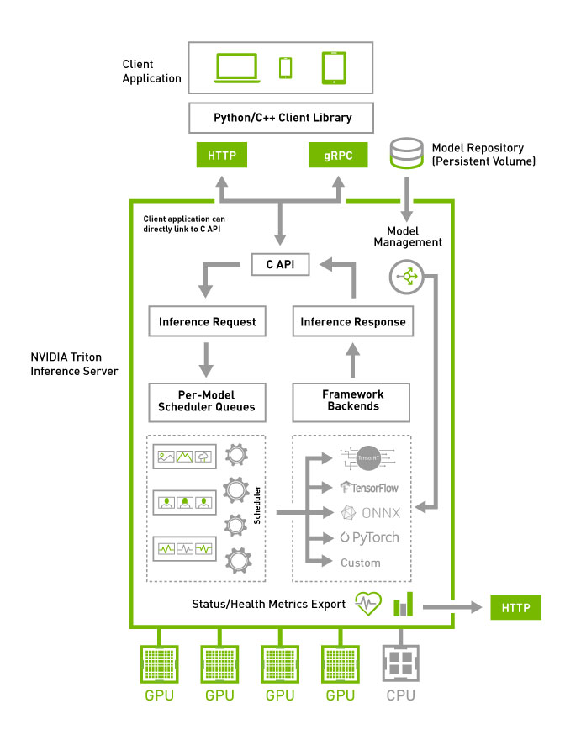
Overview of Steps Required
Create own client.
Deploy trained model.
Train the model, create config file and deploy to Triton Server.
Create own client and infer from deployed model in Triton Server.
Developer Task

Slide 5
Workflow
(with tensorflow example)
Train model
Create config.pbtxt
Deploy to Triton Server
Using MNIST_TF_2.ipynb, train a tensorflow model with MNIST data.
Save model as “savedmodel” format.
Note the model’s input and output data type and shape.
Other supported framework and model format:
Framework | Model format
Tensorflow | graphdef, savedmodel
TensorRT | plan
ONNX | onnx
Pytorch | pt

Slide 6
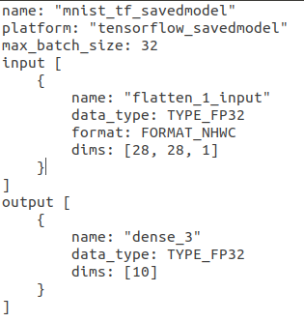
Workflow
(with tensorflow example)
Create config.pbtxt
Train model
Deploy to Triton Server
Diagram on right shows an example of the config file.
“name” must be the same as its parent folder. See next slide for example.
“platform” is specific to framework and model format; refer to https://github.com/triton-inference-server/backend/blob/main/README.md
“max_batch_size”: TBC
“input”: The MNIST takes in an image of (28, 28, 1) -> H x W x Channel.
“output: The MNIST model output probability of 10 classes.
Framework | Saved Model format | Platform
Tensorflow | graphdef | tensorflow_graphdef
 | savedmodel | tensorflow_savedmodel
TensorRT | plan | tensorrt_plan
ONNX | onnx | onnxruntime_onnx
Pytorch | pt | pytorch_libtorch

Slide 7
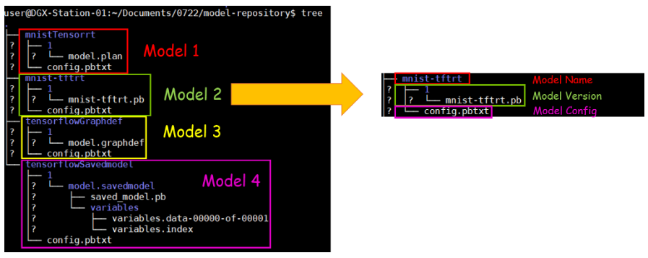
Workflow
(with tensorflow example)
Deploy to Triton Server
Train model
Create config.pbtxt
Must be same as “name” field in config.pbtxt
Deploy the trained model and its config file based on the folder structure shown in the diagram below.
An example of the trained model and its config file is available at <add github link?> and the folder structure is as shown on the diagram on the right.
Place the “model folder” under the main “model_repo**” folder as configured in the Triton Server.
model_repo
mnist_tf_savedmodel
1
model.savedmodel
variables
variables.data-00000-of-00001
variables.index
saved_model.pb
config.pbtxt
Another model
Key:
Model folder
folder
file
** Check for the exact folder name

Slide 8
Workflow
(with tensorflow example)
Deploy to Triton Server
Train model
Create config.pbtxt
Restart server to update model list. <confirm if a restart is needed>
<add print screen of the console showing model list deployed>

Slide 9
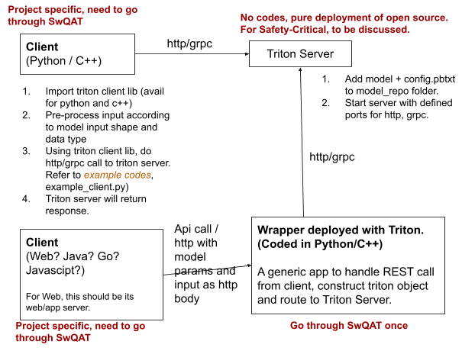
Workflow
(with tensorflow example)
Determine Client Type
Build Client
Triton Client library is available in python and C++; thus if your client is based on these languages, you can import the library and call Triton Server.
Otherwise, proposed a generic wrapper deploy with Triton server. This wrapper will exposed REST API for client to call, parse input and return response from Triton Server back to client REST request.

Slide 10
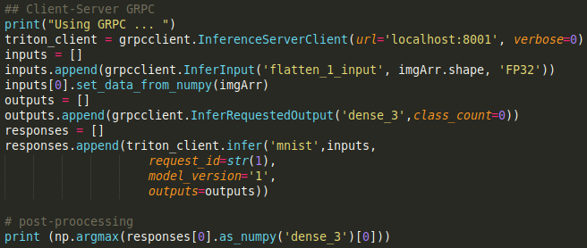
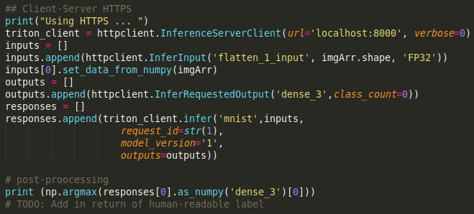
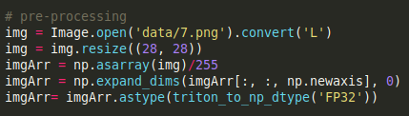
Workflow
(with tensorflow example)
Determine Client Type
Build Client
A client.py example is available <add github link>.
Client code in general contains:
Pre-processing of data to model input shape and data type.
Obtain triton client using triton client library.
Call Triton Server.
Post-processing of Triton Server’s response.
Run the client.py python client.py. You should see print out of the predicted class “7” of 7.png.

Slide 11
Resources
Resources | Source | Remarks
MNIST_TF_1.ipynb | <to add github link> | Jupyter notebook with example codes to train a tensorflow model using MNIST data. Saved as ‘savedmodel’ output.
Trained model and config file | <to add github link> | Trained model and basic config file organised according to the folder structure required.
Triton Client Libraries | <to add github link> pip3 install nvidia-pyindex pip3 install tritonclient[all] | Client libraries can be used to construct triton object to communicate with Triton Server. Available in python and C++.
client.py | <to add github link> | A sample of client doing http / grpc calls with Triton client libraries.

Slide 12
Advanced Usage

Slide 13
To be explored and added..

